Slide 1
In this segment
Early Middleware Technologies
Remote Procedure Calls
Distributed Object Oriented Components
Message Oriented Middleware (MOM)

Slide 2
Remote Procedure Calls (RPC)
Overview
RPC is a method call across the network, which is treated same as a local procedure call (location transparency)
Open Network Computing (ONC) RPC implementation (early attempt of middleware)
RPC methods defined in “.x” files
rpcgen translates .x files to stubs on client side and skeleton files on server side
Stubs and skeletons handle packing/unpacking of data from application to network layer (bytes) – called Marshaling
Applications on either side (client and server) are designed as if they run on the same machine, leaving underlying network / transport specifics to RPC runtime

Slide 3
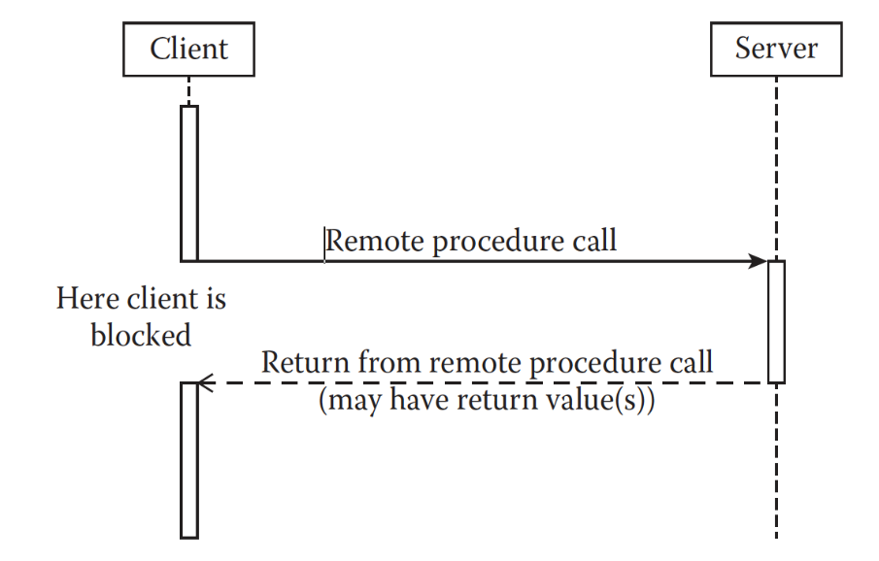
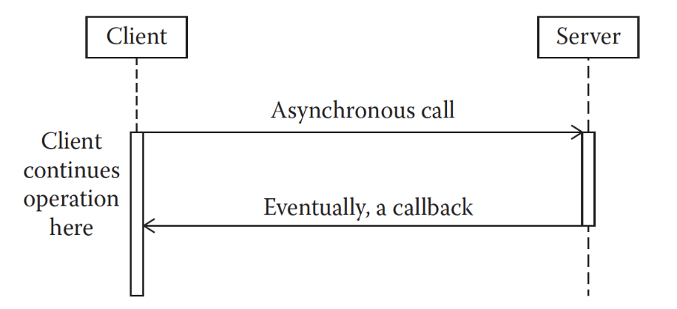
Remote Procedure Calls (RPC)
Synchronous Vs Asynchronous
Synchronous RPC blocks the client until server finishes the operation and returns response (or error)
Asynchronous RPC allows client to continue its business while server processes RPC
Client may send return address (along with request) that server can use to callback to send response
Server may use a mediator (also called broker) to return response to the client when finished
Synchronous RPC
Asynchronous RPC

Slide 4
Distributed Object Oriented Components
Overview
Distributed component is a concurrent object with a well-defined interface, which is a logical unit of distribution and deployment
Employs object oriented methodologies (where objects encapsulate data inside) to design a system, with components spread over network, communicating using middleware components
Distributed Object middleware handle both synchronous and asynchronous communication
Examples: CORBA, DCOM, Java RMI, EJB

Slide 5
Distributed Object Oriented Components
Component or Object Oriented Middleware ?
Component based systems comprises of loosely coupled components (need not be object oriented), most of which could be existing components
CORBA
DCOM
EJB
Object oriented systems focus on modeling real world situations, albeit using components at times
CORBA
DCOM

Slide 6
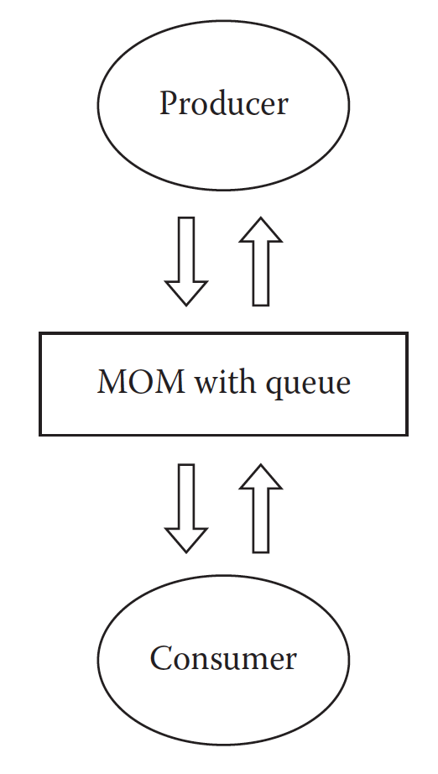
Message Oriented Middleware (MOM)
Overview
Acts as a middleman (broker) between client and server for communication
Brings in loose coupling in the design of client and server, by offloading communication to a third party
Enables client to work asynchronously with server
Generally (not necessarily always) uses queueing mechanism to deliver messages, in a publish/subscribe model
MOM will handle auxiliary operations as well, like Quality of Service, Priority processing, Reliability, Recovery of lost messages etc.

